Slide 1
Rounding Numbers and Estimation
6
7
8
6.3
7.2
7.8
2035 ≈ 2040
67 890 ≈ 68 000
8985 ≈ 9000
6.89 ≈ 6.9

Slide 2
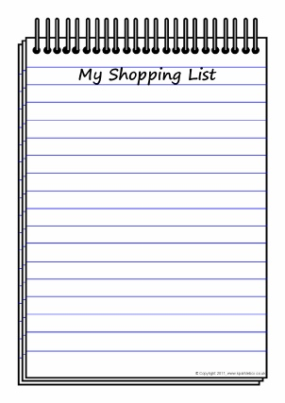

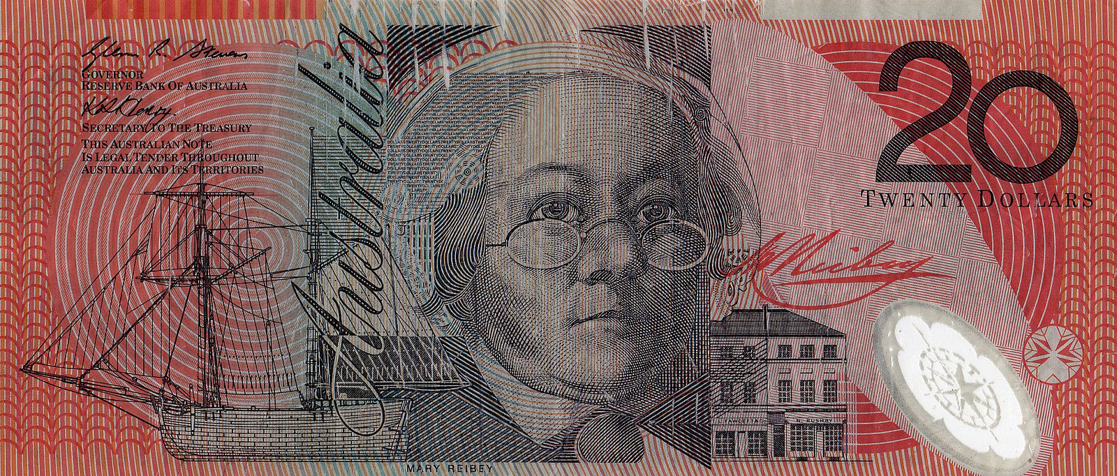
I'm gonna pop some tags
Only got twenty dollars in my pocket
2 x Milk (2L)
1 x Nutella 750 g
2 x Avocado
1 x Marshmallows Bag
Can I buy the products in the shopping list with $20?
Product | Cost
Milk (2 L) | $1.99
Nutella (750 g) | $6.75
Avocado | $3.20
Marshmallows | $2.80

Slide 3
24
7
30
Date
Rounding and Estimation
EQ – How to estimate using lead digit rounding?
In order to estimate, we must round the numbers first.
How do we round numbers?
To find the closest value, decide which is the last digit required;
  Leave it the same if the next digit to the right is less than 5.
  Increase it by 1 if the next digit is 5 or more.
7

Slide 4
Rounding To The Nearest Whole Number.
Consider the number:
6.7
It is our task to decide if the number is closer to :
6
or
7
Look at the number line below:
6
7
8
6.5
6.7
6.5 is the midpoint between 6 and 7.
Is 6.7 closer to 6 or 7 ?
Is 6.7 above or below 6.5 ?
Above
6.7 ≈ 7 (to the nearest whole number)

Slide 5
What Goes In The Box ?
Round the following to the nearest whole number:
NB: always round 0.5 up . I.e. 12.5 ≈ 13 (to the nearest whole number).
(1) 4.8
5
(6) 287.6
288
(2) 7.4
7
(7) 9.8
10
(3) 44.6
45
(8) 49.6
50
(4) 87.5
88
(9) 99.7
100
(5) 56.3
56
(10) 399.5
400

Slide 6
Rounding To The Nearest 10
Round 467 to the nearest ten.
Which number is the tens number ?
6
Is the number after the 6 greater or smaller than 5 ?
7 > 5
Rule
If the number is greater than or equal to 5 then round up.
Now round 467 to the nearest ten.
467 ≈ 470 (to the nearest ten).
460
467
470

Slide 7
Round 23 438 to the nearest hundred.
Which number is the hundreds number ?
4
Is the number after the 4 greater or smaller than 5 ?
3 < 5
Now round 23 438 to the nearest hundred.
Rule
If the number is greater than or equal to 5 then round up.
23 438= 23 400 (to the nearest hundred).
23 400
23 500
23 438

Slide 8
What Goes In The Box ? 2
Round the numbers below to the required unit:
(1) 67 to the nearest ten =
70
(2) 943 to the nearest hundred =
900
(3) 518 to the nearest ten =
520
(4) 5 218 to the nearest hundred =
5 200

Slide 9
24
7
30
Date
Rounding and Estimation
Rounding and Estimation
EQ – How to estimate using lead digit rounding?
How do we estimate?
It is not always possible or convenient to work out or give exact answer to a problem.
It is not a guess, but a quick approximation of an answer.
Method : Round to the first digit and carry out the operation.
≈ symbol is used to indicate approximation
7

Slide 10
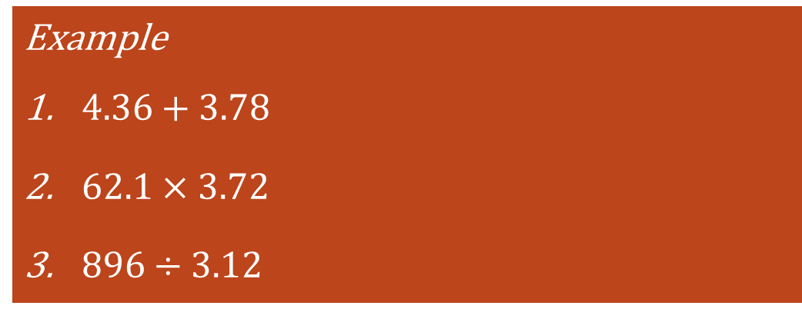
24
7
30
Date
Rounding and Estimation
Rounding and Estimation
EQ – How to estimate using lead digit rounding?
How do we estimate?
It is not always possible or convenient to work out or give exact answer to a problem.
It is not a guess, but a quick approximation of an answer.
Method : Round to the first digit and carry out the operation.
≈ symbol is used to indicate approximation
Example
$4.36+3.78$
$62.1×3.72$
$896÷3.12$
7

Slide 11
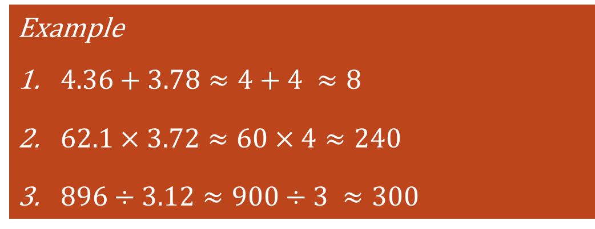
24
7
30
Date
Rounding and Estimation
Rounding and Estimation
EQ – How to estimate using lead digit rounding?
How do we estimate?
It is not always possible or convenient to work out or give exact answer to a problem.
It is not a guess, but a quick approximation of an answer.
Method : Round to the first digit and carry out the operation.
≈ symbol is used to indicate approximation
Example
$4.36+3.78≈4+4 ≈8$
$62.1×3.72≈60×4≈240$
$896÷3.12≈900÷3 ≈300$
7

Slide 12
Tasks

Slide 13
I'm gonna pop some tags
Only got twenty dollars in my pocket
2 x Milk (2L)
1 x Nutella 750 g
2 x Avocado
1 x Marshmallows Bag
Can I buy the products in the shopping list with $20?
Product | Cost
Milk (2 L) | $1.99
Nutella (750 g) | $6.75
Avocado | $3.20
Marshmallows | $2.80

Slide 14
Summary

